Slide 1
HOTEL MANAGEMENT SYSTEM An Overview Of Hotel Operations And Management.
PRESENTED BY : Radhika Yadav Vidhi Dixit Palak Pawaiya Divyanshi Dixit Bhavna Parmar

Slide 2
INTRODUCTION
Brief Intro: A Hotel Management System (HMS) is a software solution used by hotels to automate and streamline operations like reservations, check-ins/check-outs, billing, and housekeeping, all in one platform.
Definition and Purpose: An HMS helps hotels manage daily operations efficiently, providing a centralized system to handle guest services, room availability, and financial transactions, ultimately improving hotel performance.
Importance in Modern Hotels: In today's competitive hotel industry, an HMS is essential for improving efficiency, reducing human error, enhancing guest experiences, and increasing revenue. It allows seamless communication between departments, real-time data access, and better customer service, making it crucial for the success of modern hotels.

Slide 3
OBJECTIVES OF HMS
Streamlining Hotel Operations – Automating daily tasks to improve efficiency and reduce manual errors.
Efficient Booking and Reservation Management – Simplifying the reservation process for customers and staff, ensuring accurate and timely bookings.
Enhancing Customer Experience and Satisfaction – Personalizing guest services to improve overall guest satisfaction and loyalty.
Managing Finances, Billing, and Payments – Automating financial processes for accurate billing, tracking expenses, and managing payments securely.
Reporting and Analytics for Decision-Making – Providing insightful data for informed decision-making, improving operations and profitability.

Slide 4
Key Features Of HMS
Reservation Management – Seamless booking, modification, and cancellation of reservations.
Front Desk Operations – Streamlined check-in, check-out, and guest registration.
Room Management – Efficient room allocation, availability tracking, and maintenance management.
Billing and Payments – Automated billing, invoicing, and secure payment processing.
Guest Services – Personalized guest requests, concierge services, and support.
Reporting and Analytics – Real-time reports and insights for data-driven decision-making.
Multi-Channel Integration – Integration with online travel agents (OTAs), websites, and mobile apps.
Security Features – Data encryption, access control, and secure payment systems.

Slide 5
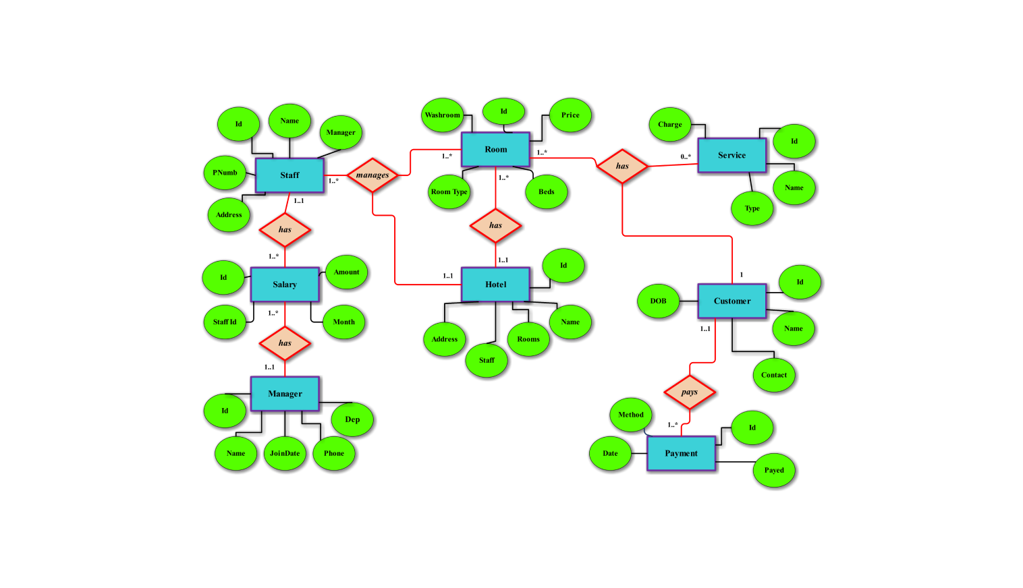
ER-DIAGRAM

Slide 6
Types Of HMS
On-Premise Systems – Installed and operated locally on the hotel's servers; full control but requires maintenance and updates.
Cloud-Based Systems – Hosted on the cloud; accessible from anywhere, with automatic updates and lower upfront costs.
Hybrid Systems – Combines both on-premise and cloud solutions, offering flexibility and scalability.
SOFTWARE NAMES
Exceed Software – Cloud Based
Aiosell Software
Hotelogix Software – Cloud Based
Ibs Software – Cloud Based

Slide 7
Technologies Used In HMS
DB Management – SQL and NoSQL databases for efficient data storage and retrieval.
Cloud Computing – AWS, Microsoft Azure, Google Cloud for scalable, secure, and accessible hosting.
Mobile Applications – Guest apps for booking, mobile check-in/check-out for enhanced convenience.
POS Systems – Integration with point-of-sale systems for restaurants, bars, and other services.
Automation Tools – AI-based chatbots and automated check-in/check-out for improved efficiency.

Slide 8
Benefits Of HMS
Increased operational efficiency .
Better guest experience and satisfaction.
Cost reduction and increased revenue .
Real-time data and insights for
decision-making .
Improved staff coordination and productivity .

Slide 9
Challenges In Implementing A HMS
High Initial Cost – Significant upfront investment for hardware, software, and setup.
Integration with Existing Systems – Challenges in syncing with current tools and processes.
Training Hotel Staff – Time and resources needed to train staff on new systems.
Data Privacy and Security Concerns – Ensuring the protection of guest data from breaches.
Internet Connectivity Issues (for Cloud-Based Systems) – Dependence on reliable internet for cloud systems to function effectively.

Slide 10
Case Study /Examples Of HMS
Opera PMS
Widely used in large hotels and chains for managing reservations, guest services, and operations.
Offers seamless integration with other hotel systems and is known for its scalability.
Hotelogix
A cloud-based solution perfect for small to medium-sized hotels.
Provides features like front desk management, bookings, billing, and reporting, all accessible from any device.
RMS Cloud
A robust, cloud-based hotel management system that offers flexibility for hotels of all sizes.
Features include booking management, guest communication, and financial tracking, with real-time updates and integrations.
This keeps the examples clear and relevant for your presentation!

Slide 11
Here’s a brief overview of two real-life examples where hotel management systems have been successfully implemented:
Marriott International (Opera PMS)
Overview: Marriott International uses Opera PMS to manage its large network of hotels globally.
Success: The system helps streamline operations across multiple properties, from reservations to guest services. It allows for seamless integration with other hotel systems and provides real-time data, improving efficiency and guest satisfaction.
The Leela Palace (Hotelogix)
Overview: The Leela Palace, a luxury hotel in India, implemented Hotelogix, a cloud-based property management system.
Success: Hotelogix helped improve the front desk operations, booking process, and guest communications. The system’s cloud-based nature allowed staff to access it remotely, making it easier to handle bookings and manage hotel operations effectively, even during high-demand periods.
These examples show how hotel management systems can streamline operations and improve guest experiences.

Slide 12
Importance Of A HMS
A Hotel Management System (HMS) is crucial for improving operational efficiency, enhancing the guest experience, and driving business growth.
Streamlines Operations – Automates daily tasks like bookings, check-ins, and billing, reducing manual errors.
Improves Guest Satisfaction – Offers personalized services and efficient handling of guest requests, leading to higher satisfaction.
Boosts Financial Management – Provides accurate billing, financial tracking, and reporting for better financial control.
Enhances Decision-Making – Offers real-time analytics and insights, helping management make informed decisions.
Integrates with Other Systems – Seamlessly integrates with POS, booking engines, and other third-party tools to provide a unified experience.
In short, an HMS is essential for modernizing hotel operations, improving profitability, and creating memorable guest experiences.

Slide 13
The Future Of HM Technology
Here’s a brief overview of the future of hotel management technologies :
Artificial Intelligence (AI)
Personalized Guest Experience: AI will be used to predict guest preferences and offer personalized services, from room settings to dining options.
Chatbots & Virtual Assistants: AI-powered chatbots will handle guest inquiries, booking, and even room service requests, enhancing convenience.
Internet of Things (IoT)
Smart Rooms: IoT will enable smart rooms, where guests can control lights, temperature, and entertainment through their devices.
Operational Efficiency: IoT devices will monitor energy usage, automate room cleaning schedules, and detect maintenance issues before they become problems.
Cloud Computing
. Scalability & Flexibility: Cloud-based systems will continue to dominate, offering hotels flexibility to scale operations, integrate with external systems, and ensure accessibility from anywhere.

Slide 14
Robotics
Automated Services: Robots may be used for room service delivery, luggage handling, or even concierge services, reducing labor costs and improving efficiency.
Blockchain Technology
Secure Payments & Transactions: Blockchain could provide enhanced security for online payments and reservations, reducing fraud and ensuring data integrity.
In summary, the future of hotel management will be shaped by technologies like AI, IoT, and cloud computing, driving automation, personalization, and operational efficiency for a more seamless guest experience and improved hotel management.

Slide 15
Feedback
Collection Guest Surveys: Post-checkout surveys for service quality, cleanliness, and amenities.
Online Reviews Analysis: Monitor platforms like Google, TripAdvisor for recurring issues or praise.
Employee Suggestions: Regular staff meetings to gather internal feedback.
Bug Reports/User Issues: Feedback from receptionists and managers using the system.
Identified Areas for Improvement
User Interface (UI): Simplify booking and billing screens.Performance
Optimization: Speed up database queries during peak hours.Mobile
Compatibility: Improve responsiveness for tablet and mobile devices.
Automated Reports: Add customizable templates for daily/monthly reports.
Integration: Include support for third-party apps (e.g., payment gateways, CRMs).
"By continuously gathering feedback and implementing these improvements, our hotel management system aims to provide a seamless, efficient, and guest-friendly experience."

Slide 16
Final Thoughts On The Impact Of HMS On The Hotel Industry :
Here are some final thoughts on the impact of hotel management systems on the hotel industry:
Hotel management systems have revolutionized the hospitality industry by driving operational efficiency, enhancing guest satisfaction, and improving profitability. With the integration of advanced technologies like AI, IoT, and cloud computing, these systems enable hotels to offer personalized services, optimize resource management, and adapt to changing customer expectations.
By automating tasks such as reservations, billing, and guest communications, hotels can reduce human error, lower operational costs, and focus more on guest experience. Moreover, real-time data and analytics empower hotel managers to make informed decisions, boost revenue, and enhance operational strategies.
In essence, hotel management systems are not just tools but a critical driver of innovation and competitiveness in the industry. As technology continues to evolve, these systems will play an even greater role in shaping the future of hospitality, offering better service, efficiency, and growth opportunities for hotels worldwide.

Slide 17
CONCLUSION
In conclusion, a Hotel Management System (HMS) is an essential tool for modernizing hotel operations. By streamlining tasks like reservations, billing, guest services, and reporting, HMS significantly improves operational efficiency and guest satisfaction. With the integration of advanced technologies such as AI, IoT, and cloud computing, these systems will continue to evolve, offering personalized experiences, enhancing security, and driving profitability.
As the hospitality industry becomes more competitive, adopting a robust hotel management system is no longer optional—it’s a critical investment for staying ahead of the curve, delivering exceptional service, and ensuring long-term success.

Slide 18
THANKYOU

